Slide 1
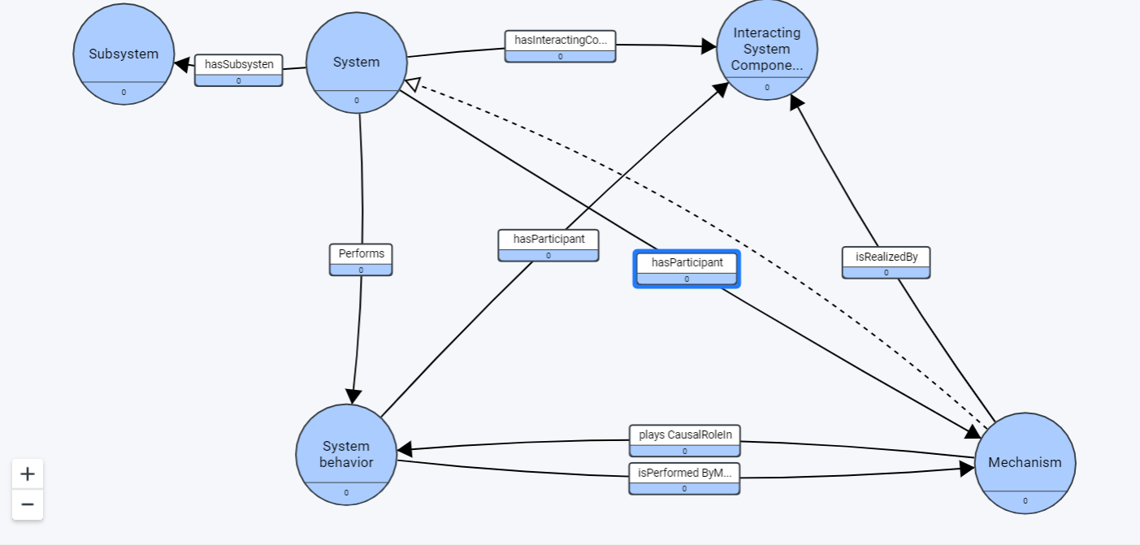
Systems – Behavior, Mechanisms, Components

